Slide 1

Program Name: Masters of Computer Applications
Academic Year: 2021-2022 Winter Semester
Year: FYMCA , Sem-II
Subject Code: MCA 203
Big Data Analysis
Course Instructor: Yudhishthir Raut
Lab Instructor: Madhuri Pagale

Slide 2
Submitted by: PRN:
Bharti Hotchandani 20210804021
Honey Denbani 20210804025
Ujwal Patil 20210804033
Pratik Ugale 20210804043

Slide 3
OUTLINE
INTRODUCTION
SIGNIFICANCE
BASIC STRUCTURE
FACE DETECTION
CONCLUSION
FUTURE WORK

Slide 4


INTRODUCTION
Traditionally attendance is marked manually by teachers and they must make sure correct attendance is marked for respective student.
This whole process wastes some of lecture time and part of correct information is missed due to fraudulent and proxy cases.

Slide 5
INTRODUCTION
In order to determine classroom attendance, face detection and face recognition are performed. Face detection is used to determine the location of the faces in the classroom image and extract sub images for each face. Then, in face recognition, the face images detected will be compared with the data base consisting of images of students in the class, and attendance will be recorded accordingly.

Slide 6
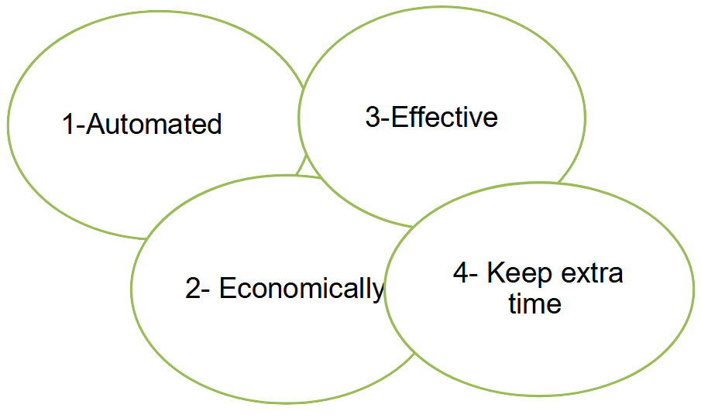
Significance

Slide 7
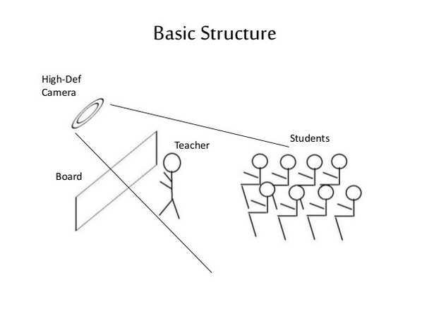

Slide 8
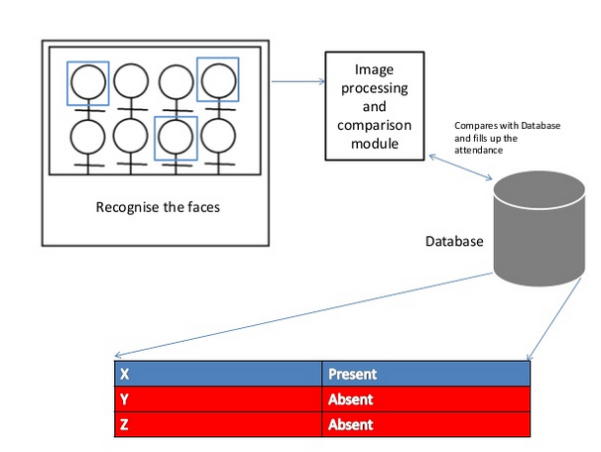

Slide 9
FACE DETECTION
Face detection is a computer technology used to identify human faces in digital images by determining the location of the faces in the image and extract sub images for each face.

Slide 10
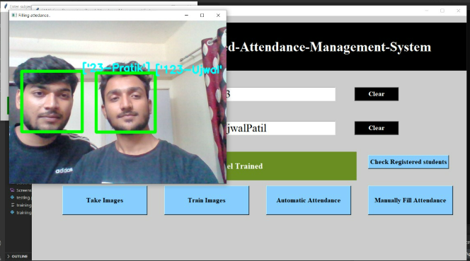
EXAMPLE OF DETECT FACE

Slide 11
HOW DO WE CREATE DATABASE
Database is the collection of face images and extracted features. And the database includes names of students & registertion number for each student .
We created a data base for 18 persons, were we took 10 images per person using raspberry pi model 2 cam, these images were taken at different times and with variations in illumination, facial expressions, and facial details.

Slide 12

EXAMPLE OF DATABASE IMAGE

Slide 13
EXAMPLE DATABASE ABOUT THE INFORMATION OF STUDENTS

Slide 14
When we applied the openCV python code, the code was able to successfully recognize the faces, it detect the faces and write the names of recognized persons as shown:

Slide 15

Then the code will creates a text file for present students as shown:

Slide 16
CONCLUSION
From our experiment, we noticed the face recognition was sensitive to face background, light, and head orientations. This technique described the accurate and efficient method of automatic attendance in the classroom which could replace the traditional method. An automatic attendance has many advantages, most of the existing systems are time consuming and require semi manual interference from lecturers, our system seeks to solve these issues by using face recognition in the process to save the time and labor. And No need for installing complex hardware for taking the attendance in classroom, all we need is a camera and laptop. We used algorithms that can detect and recognize faces in the image.

Slide 17
Future work
Automatic attendance system can be improved by increasing the number of features which can be extracted to increase accuracy of face recognition. Once the software is developed and tested properly, it could be improved to cover full institutions such as the faculty of engineering.

Slide 18
THANK YOU

